Slide 1
Bruce Power - Outage AI Project
January 2021
Notes:
Paul
Welcome to our latest edition of our Technology Webinar Series. I hope you are all safe and where possible working from home. A big shout out and thankyou to all the front-line staff, first responders, and anyone who is helping as our world wide community goes through this Covid struggle. I am excited about todays topic. We have been talking about the new norm for a while now, during the next 30 minutes we want to really dive into how to achieve high performance collaboration while working from home – specifically using Microsoft Teams.

Slide 2
Technical Architecture
NOTES
Redis cache may not be required
Uses Existing API Gateway
Search engine SOLR(on-premise) vs Algolia(cloud)
Staging site needs to be secured with KeyCloak
Static Site Generator invoked on changes (except Alerts/Search)
ETL Tool (if is this needed) – need to research data sets
Admin site can possibly leverage existing platforms like Intranet/SharePoint

Slide 3
Strapi vs Drupal
Feature | Strapi | Drupal
Authoring | Disconnected from front end | Inline Authoring
API | Build in auto-generated/Good API Management tools | Needs Plugin/More complex to setup and manage
Forms | Not available | Forms plugin allow no code forms authoring
Publishing | Basic draft/publish for all content. No workflow | Full editorial Workflow including site preview
Plugins | Small set of stable plugins available | Large library of stable plugins including feature like SEO/Social Media/CDN integration
Community Support | Smaller support community | Large community of online support and developers
Complexity | Easy to install/setup, use and customize | Much more complex setup and has a much larger technical footprint
Common deployment scenario | Smaller static web site primarily managed by technical web admins and focused on API management | Larger more dynamic and complex web sites managed by communications and marketing teams

Slide 4
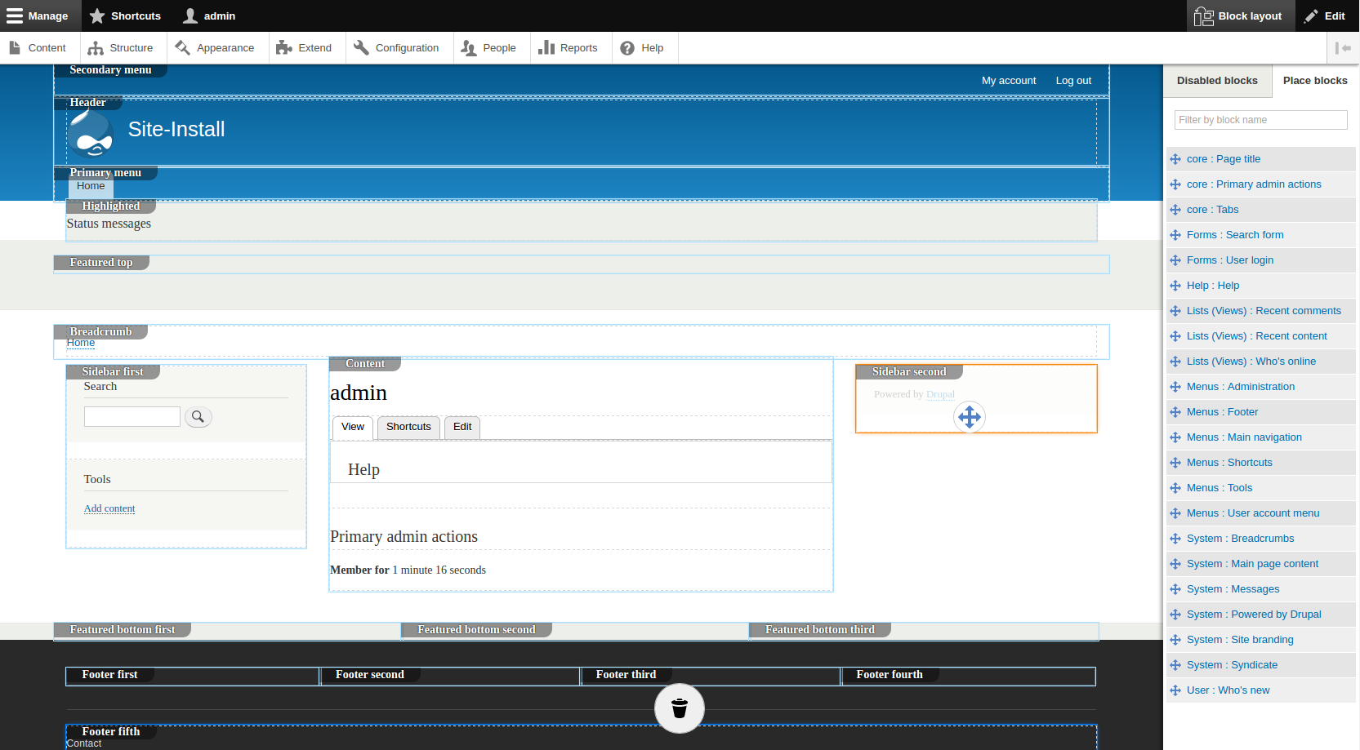
Drupal Authoring Experience

Slide 5
API Architecture

Slide 6
API Gateway – DataBC
Kong API Gateway (https://developer.gov.bc.ca/API-Gateway-(powered-by-Kong-CE))
Registration URL for Kong https://argg.apps.gov.bc.ca/int/
Vanity URL (https://api.bcparks.ca)
API Keys
Rate Throttling
Self Service API Key Generation
OpenAPI Spec
API Catalog registration https://catalogue.data.gov.bc.ca/dataset

Slide 7
API Design Considerations
API Versioning eg https://api.bcparks.ca/v1/parks
Naming convention – camelCase
Basic Strapi Authentication – 2 users : public/admin (SSO requires Strapi GOLD edition)
Custom routing in Strapi
/park/<ORCNumber>/advisories
/park /<ORCNumber>/ fees/
Data BC API standards https://github.com/bcgov/api-guidelines/blob/master/government-of-british-columbia-api-guidelines.md

Slide 8
Site Architecture
NOTES
Load balanced public facing containers
Site build triggered on demand
Gatsby hosted on staging container
Storage mounted as read only to public containers
Gatsby Strapi plugin
Where to store images – CMS vs storage vs CDN

Slide 9
Resource Space (www.resourcespace.com)
Runs on LAMP Stack
Large monolithic application
System Requirements
16GB RAM minimum
Intel Xeon
Storage with volume mounts
Optional – separate preview and original files
S3 Storage Options
OCIO S3 Compatible Object Store
High latency
Low read rate
File mount for VM only
$0.07 /GB/month

Slide 10
Hosting Option – Virtual Machines
2 Virtual Machines
Media Storage
Preview on Tier 3
Original Files on Object Storage
Costs
VM ~ $1000/month
Tier 3 Storage 50GB - $27.5 /month
Object Store 1TB - $70/month
Optional Montala Support Costs

Slide 11
Hosting Option – Openshift
Larger spec containers
S3FS driver for S3 volume mount
Need a POC
No CDN Integration
Costs
Containers & Local Storage - TBD
Object Store 1TB - $70/month
Optional Montala Support Costs

Slide 12
Hosting Option – Azure
Azure Container Instances/ Azure VM
Need a POC
Azure storage HOT & COLD
Integration with Azure CDN
Canadian Data Center
Costs
Compute ~ $400/month
HOT Storage 50GB - $5 /month
COLD Storage 1TB - $80/month
Optional Montala Support Costs

Slide 13
Public Facing Access
Custom web site
Simple browser and search
Preview files on local storage (copy of Resource Space file share)
Offline downloading original files

Slide 14
ETL Tool – Scope
Single Platform
Container friendly
Notifications
Easy to troubleshoot
Scheduler
Retry Logic
Support API Connectors
Visual Dashboard/Remote Administration

Slide 15






Open Source ETL Platforms
Platform | Language | Container Support
 | Python | Yes | Workflow Task Orchestration/Scheduling platform. ETL Pipelines built using custom code. Management UI included for monitoring. Error handling, notification support
 | Python | Yes | Workflow Task Orchestration/Scheduling platform. ETL Pipelines built using custom code. Management UI included for monitoring. Error handling, notification support
 | Any | Yes | Data Ingestion platform used for data warehouses. Large number of connectors. Management UI included. No support for pipelines and relies on orchestration tools like AirFlow for further processing. Error handling, notification support
 | Python | Yes | CLI based ETL platform. No orchestration or monitoring. Largest support for connectors. No management UI. No pipeline support
 | Python | Yes | ETL platform including orchestration. Built on top of Singer. Management UI included. No pipeline support
 | Java | No | ETL Platform with visual authoring of pipelines

Slide 16
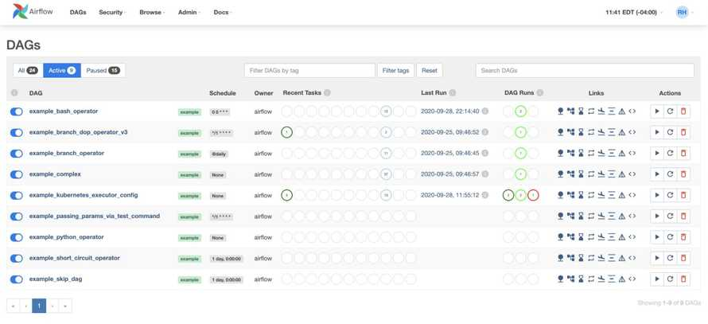
ETL Tool – Apache Airflow
Scalable
Container friendly
Python pipelines for data transformation
Supports HTTP Connector
Operations Dashboard
Failure Notifications
Scheduler

Slide 17
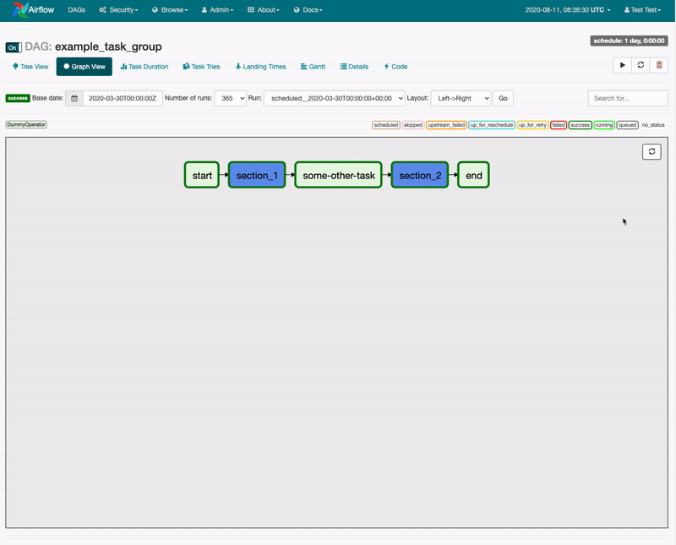
ETL Tool – Apache Airflow
Visual representation of pipeline
Click on task for status/error logs
Metrics at the task level
Manage connection information
Configure retry logic
Navigate logs

Slide 18
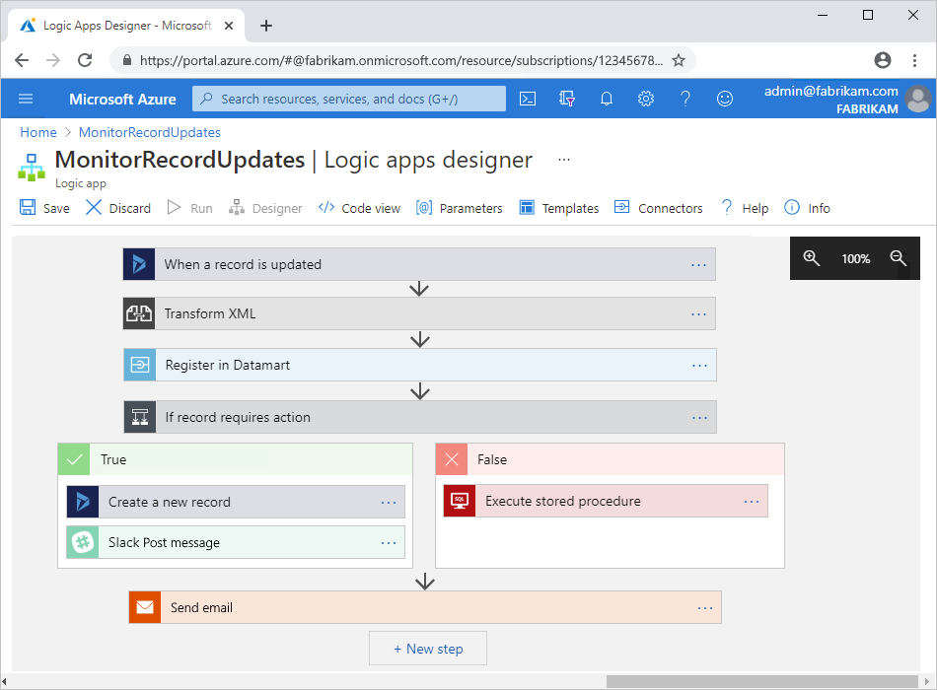
Azure Logic App / Azure Data Factory
Software as a Service
Visual no-code authoring
Monitoring dashboard
Failure Notifications
Visual debugging
Pay per action/step

Slide 19
Strapi Page Content Design
Strapi has no concept of sites or pages
Implement content types
Detail based on ease of maintenance

Slide 20
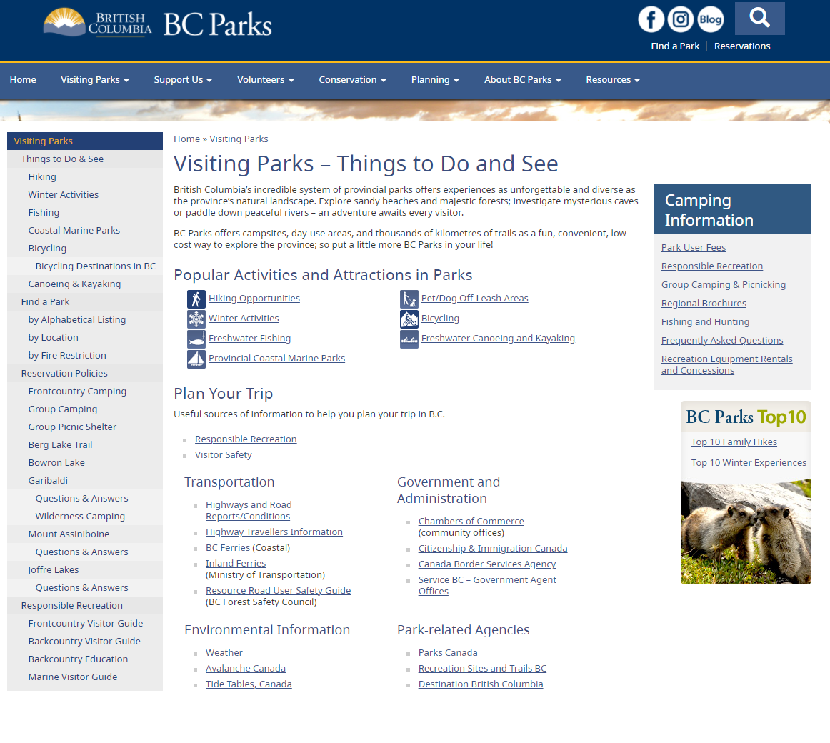
Strapi Content Types
Header
Web
Navigation
Page Template
Page
Components
Eg Rich Text, Image etc

Slide 21
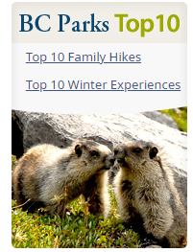
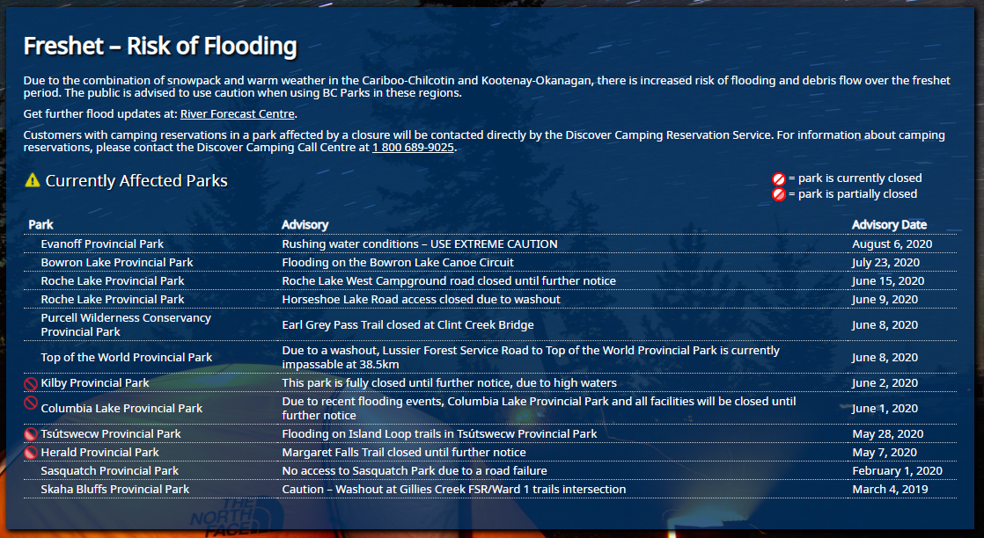
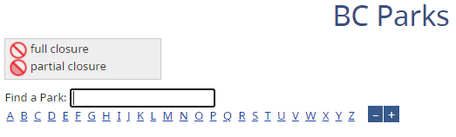
Page Component Types
Component | Description | Example
HTML/Rich Text | Generic HTML area
Image | Image external or internally referenced
Video | Video external or internally referenced
Public Advisory Summary | Summarized list of advisories
Public Advisory Full | Full list of advisories
Find Park | Park search

Slide 22
Notes:
paul

